Slide 1
CSE322
CONVERTING REGULAR EXPRESSION(RE) TO REGULAR GRAMMAR(RG) & RG TO RE
Lecture #17

Slide 2
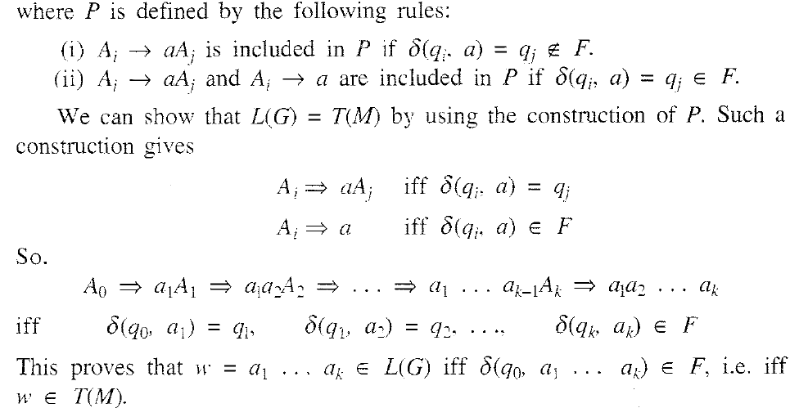
CONVERITNG RE TO RG
We have to construct a
Notes:
We have to construct a

Slide 3
NUMERICAL
Notes:
We have to construct a

Slide 4
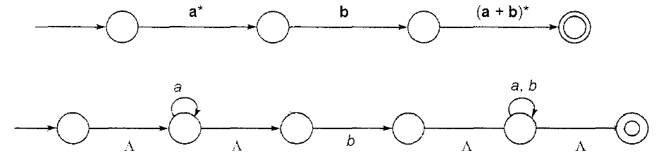
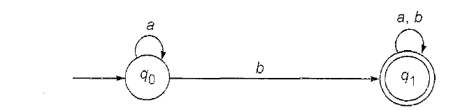
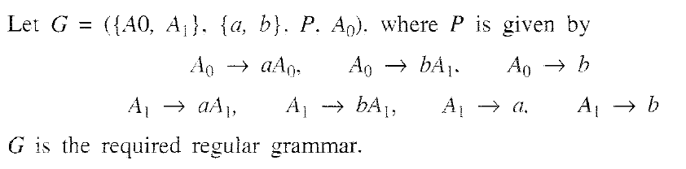
SOLUTION
Notes:
We have to construct a

Slide 5
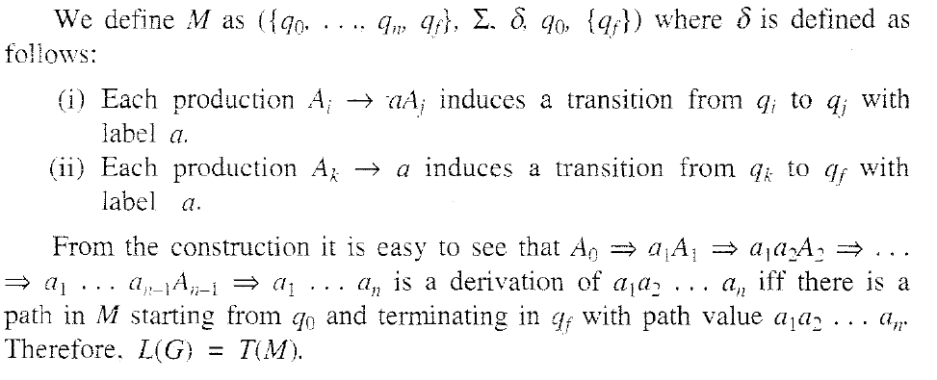
CONVERSION OG RG TO RE
CONSTRUCTION OF TRANSITION SYSTEM M ACCEPTING L(G) FOR A GIVEN REGULAR GRAMMAR G
Notes:
We have to construct a CONSTRUCTION OF TRANSITION SYSTEM M ACCEPTING L(G) FOR A GIVEN REGULAR GRAMMAR G

Slide 6
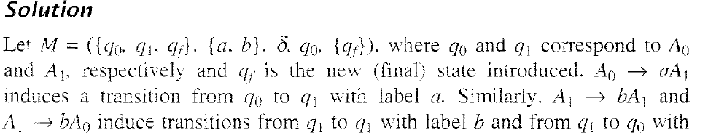
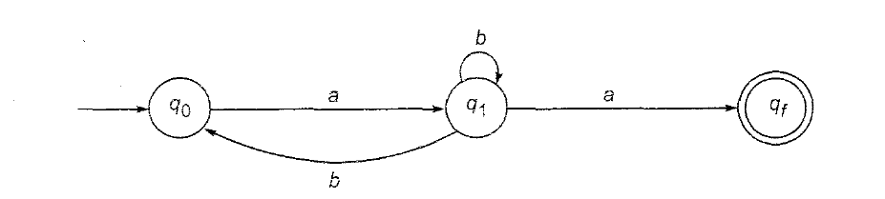
NUMERICAL
Notes:
We have to construct a

Slide 7
NUMERICAL
Notes:
We have to construct a

